Slide 1
Carbon Sequestration Pitch
Kate Baker, Nika Gorski, Caroline Willett

Slide 2
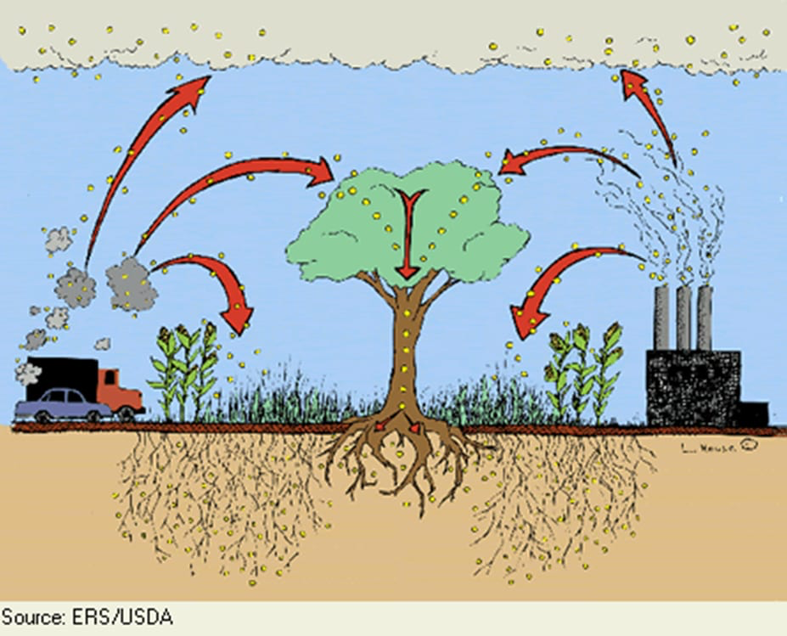

Slide 3
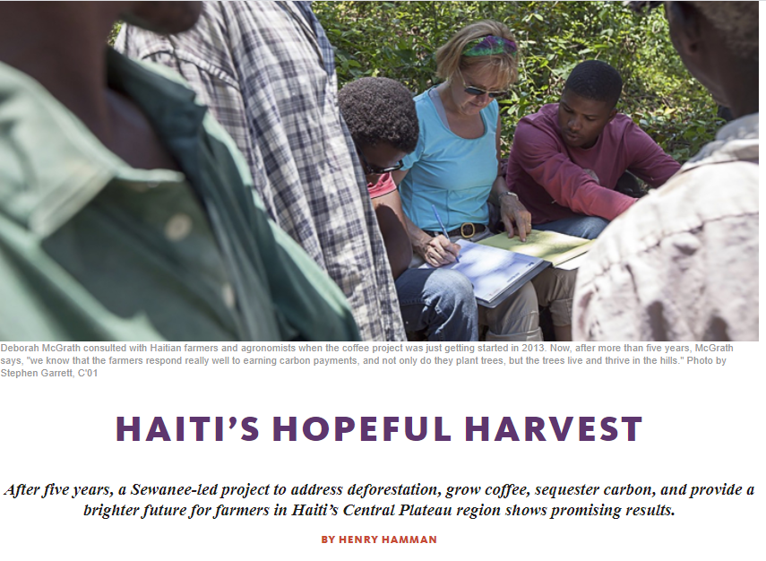
Working With Data
Organize, clean, and assure that the data is accurate
Test and compare carbon sequestration equations
Establish an impeccable dashboard
Search for solutions
Scale up project and monitoring
Improve method of carbon payments

Slide 4

Overarching Goals
Sustainable income
Improved soil quality
Increased agricultural productivity and food security
Allow Dr. McGrath and Sewanee’s Partners in Agriculture Program to collaborate remotely and accurately
Is this model feasible as a large-scale solution?

